Slide 1
Stock Segmentation for an online retail Service
Submitted by:
Vignesh V Rao
A. S. Sathvik
Deepika R
Sriharsha B V
Amrutha Sagar L
Under the supervision of
Mrs. Vidhya K

Slide 2
Problem Statements
Segmentation of stock based on the frequency of purchase, the quantity of purchase of stocks to enable better inventory management.
The company sells a vast range of products to customers in various locations that would involve shipping. Also, the rate of purchase is not common throughout the year. The movement of products from the shelves also varies. Considering that the product is a gift item, it becomes imperative that the stocks be available on-demand to ensure that the delivery dates are met. How do we classify the products under different classes to ensure proper availability of stock, to avoid delays of delivery and also to avoid a particular product staying in the shelves for too long?

Slide 3
Objective
This study is about performing Stock Segmentation and Customer Congregation for an online retail service using analytics data. More than a year’s data has been collected by the retail which needs business strategies to increase their sales, deliver customer requirements, plan the inventory, and increase sales by widening the horizon.

Slide 4
Dataset Description
Numerical variables - 3
Categorical variable - 5
There are 136149 null values in 532619 observations/rows
There are no redundant columns in the dataset
Sr.No | Variable Name | Category | Info
1. | InvoiceNo | Categorical | 532619 non-null object
2. | StockCode | Categorical | 532619 non-null object
3. | Description | Categorical | 531165 non-null object
4. | Quantity | Numerical | 532619 non-null int64
5. | InvoiceDate | Categorical | 532619 non-null object
6. | UnitPrice | Numerical | 532619 non-null float64
7. | CustomerID | Numerical | 397924 non-null float64
8. | Country | Categorical | 532619 non-null object

Slide 5
Stock Segmentation
1
Exploratory Data Analysis

Slide 6
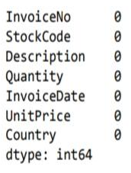

Missing Value Treatment
The 0 and negative values in the unit price are removed since it denotes no purchase or returns/defective.
Removing the 0 and negative values of unit price has removed negative quantities too.
Some of the stocks like ‘AMAZON FEE’, ‘POST’ and so on do not require inventory management.

Slide 7
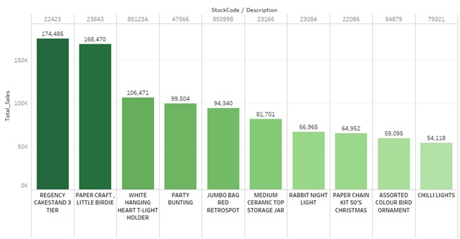
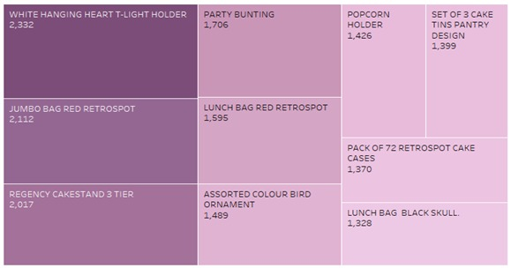
Feature Engineering
Total Sales Stock REGENCY CAKESTAND 3 TIER has the maximum sales with 174K pounds revenue. Offers can be given on the same for wholesale purchases and inventory can be increased. The range of sales for stocks is from 174K pounds to 55K pounds for only 10 stocks. This denotes that cluster size with more revenue might be less.
Frequency These products are purchased frequently. Providing offers can increase sales. The revenue and quantity of these products may not high but stocking up these items can help catering to regular buyers.

Slide 8
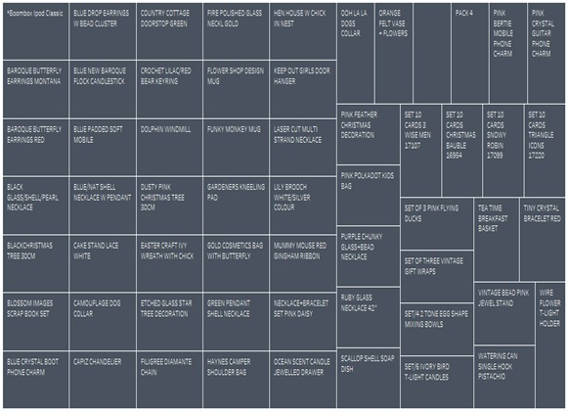
Quantity 58 out of 3799 products were ordered only once in the entire year. Based on customer purchase, focusing less on the products rarely bought would be an ideal inventory solution.

Slide 9
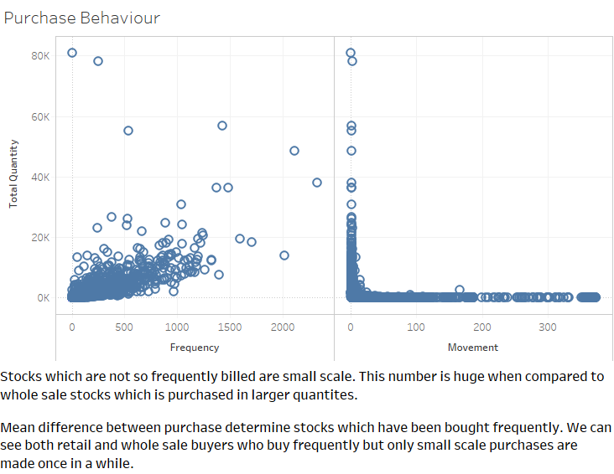
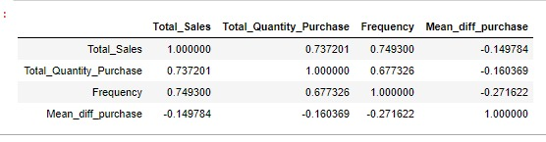
Mean Difference between purchase The Mean difference between purchase determine stocks which have been bought frequently. We can see both retail and wholesale buyers who buy frequently but only small-scale purchases are made occasionally.
Correlation Two features, total quantity and frequency seems to have good correlation. As the number of visits increase, purchase also increases. Total quantity purchased per product is not much correlated with average sales which tells us both value of product is not high even when purchase is made.

Slide 10
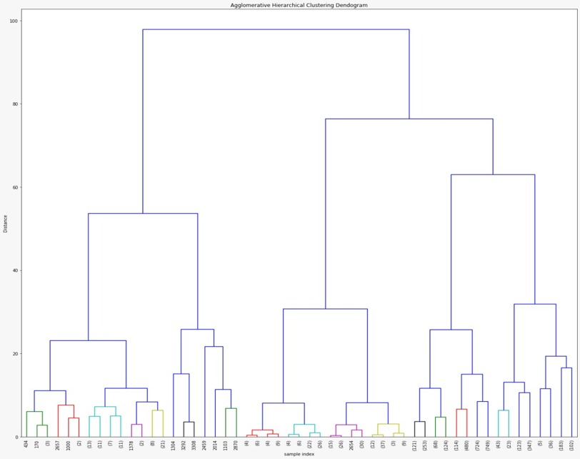
Algorithm considered
Agglomerative Clustering:
Stocks segmentation is done considering various features which are generated through feature engineering and the data is scaled as agglomerative also works on distance basis.
Based on the dendrogram generated, we can see 2 clusters forming with minimal distance.
Therefore, we are going with 5 clusters which has clear separation and maximum distance between each other.
We can see 2 subclusters on left and 3 subclusters on the right.

Slide 11
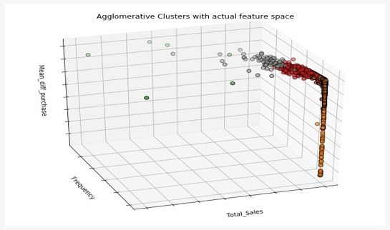
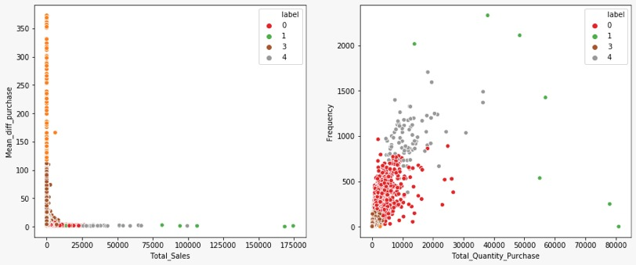
Solution Architecture
The clusters have defined boundaries with respect to total quantity and total purchase.
Good inferences can be drawn in terms of hidden/underlying patterns which forms the subclusters.
 | K-Means | Agglomerative
Inertia | 4885.57 | 2757.85
Silhouette Score | 0.685 | 0.5393
Cluster Value Counts | 0: 358 1: 3259 2: 171 3: 11 | 0: 862 1: 7 2: 214 3: 2633 4: 83

Slide 12
Conclusion
Clusters | Total Quantity | Description
0 | < 5K | Stocks bring in moderate income and inventory needs to be maintained to meet the demand to supply ratio.
1 | > 40K | Stocks which cater to large scaled market and bring in maximum income. A very large share of inventory must be invested in these products. This strategy can attract customers overseas due to high supply.
2 | < 10 | Stocks with low frequency and very less income. These stocks can be omitted from future selling.
3 | < 500 | Stocks which bring in low income but purchased once in a while. A small portion of inventory can be allocated as they cater to one set of customers.
4 | > 10K | Stocks which bring in good sales and in demand.

Slide 13
Recommendations
The cluster comprising the most loyal customers need to be given high attention and their purchase patterns must be individually assessed so that the company is always ready for them.
These customers need to retained through efficient inventory management.
Unit Price Standardization: Range of prices marked for a single product can be standardized.
Segment specific promotional and marketing strategies can be developed.
Follow ups - Capstone Project
Basket Analysis: Association rule attempts to find common patterns of purchase in large datasets. This will help in finding unexpected patterns in purchase of an individual.
Forecasting: Revenue forecasting can be done using LSTM.

Slide 14
THANKS!
Any questions?

